Slide 1


UNIVERSITY INSTITUTE OF ENGINEERING
COMPUTER SCIENCE & ENGINEERING
Introduction to Information Security
(Subject Code:20CST-354/ITT-354)
Prepared By : Er. Puneet kaur (E6913)
INTRODUCTION
DISCOVER . LEARN . EMPOWER

Slide 2
Transposition Techniques
Transposition Techniques
Rotor Machines
Steganography

Slide 3
Transposition Ciphers
Also called permutation ciphers.
Shuffle the plaintext, without altering the actual letters used.
Example: Row Transposition Ciphers

Slide 4
Row Transposition Ciphers
Plaintext is written row by row in a rectangle.
Ciphertext: write out the columns in an order specified by a key.
Key: 3 4 2 1 5 6 7
Plaintext:
Ciphertext: TTNAAPTMTSUOAODWCOIXKNLYPETZ

Slide 5
Product Ciphers
Uses a sequence of substitutions and transpositions
– Harder to break than just substitutions or transpositions
This is a bridge from classical to modern ciphers.

Slide 6
Rotor Cipher Machines
Before modern ciphers, rotor machines were most common complex ciphers in use.
Widely used in WW2.
Used a series of rotating cylinders.
Implemented a polyalphabetic substitution cipher of period K. With 3 cylinders, K = 26³ =17,576.
With 5 cylinders, K = 26⁵ =12 x 10⁶. What is a key?
If the adversary has a machine
If the adversary doesn’t have a machine

Slide 7
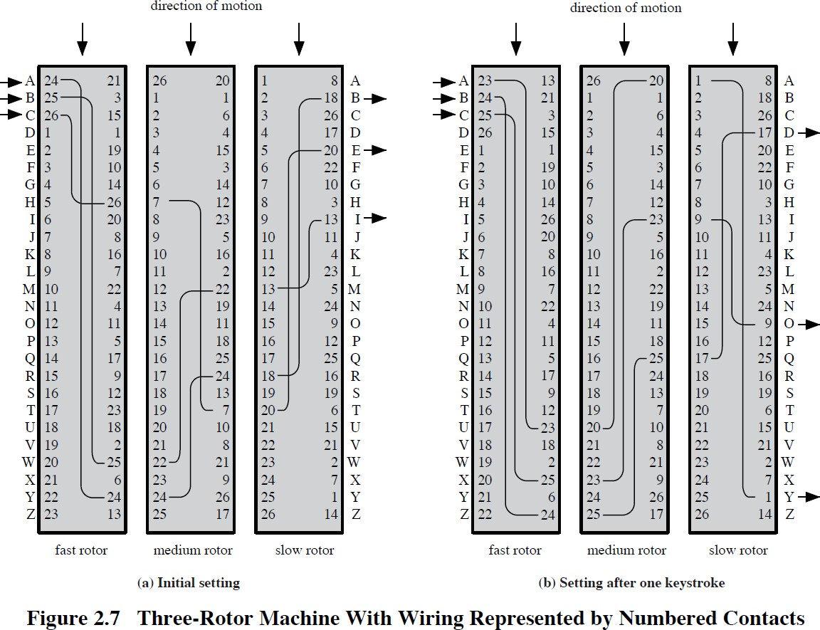

Slide 8
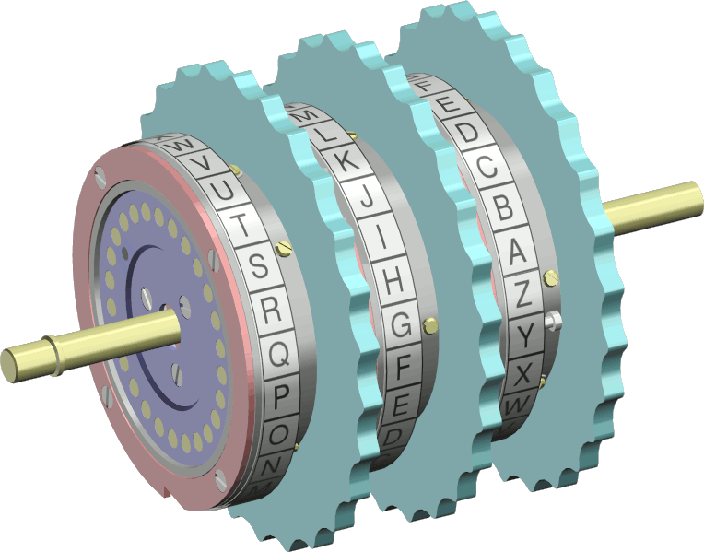
The Rotors

Slide 9
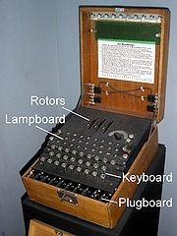
Enigma Rotor Machine

Slide 10
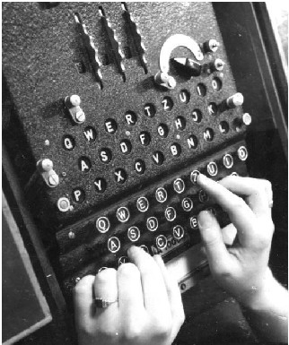
Enigma Rotor Machine

Slide 11
Steganography
Hide a message in another message.
E.g., hide your plaintext in a graphic image
Each pixel has 3 bytes specifying the RGB color
The least significant bits of pixels can be changed w/o greatly affecting the image quality
So can hide messages in these LSBs
Advantage: hiding existence of messages
Drawback: high overhead

Slide 12
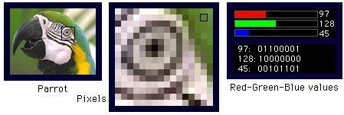
Take a 640x480 (=30,7200) pixel image.
Using only 1 LSB, can hide 115,200 characters
Using 4 LSBs, can hide 460,800 characters.

Slide 13
Summary
Have considered:
classical cipher techniques and terminology
monoalphabetic substitution ciphers
cryptanalysis using letter frequencies
Playfair cipher
polyalphabetic ciphers
transposition ciphers
product ciphers and rotor machines
stenography

Slide 14
References
http://www.brainkart.com/article/Classical-Encryption-Techniques_8339/
https://www.tutorialspoint.com/cryptography/index.htm
https://www.geeksforgeeks.org/cryptography-introduction/
https://www.techopedia.com/definition/1770/cryptography#:~:text=Cryptography%20involves%20creating%20written%20or,information%20to%20be%20kept%20secret.&text=Information%20security%20uses%20cryptography%20on,transit%20and%20while%20being%20stored.
https://www2.slideshare.net/lineking/classical-encryption-techniques-in-network-security?qid=e388c29f-793d-4f2b-bcaf-9d22e9ca07b5&v=&b=&from_search=1

